Slide 1



Pivotal Cloud Foundry
Services Overview
Ben Bertka / Platform Architect
bbertka@pivotal.io

Slide 2
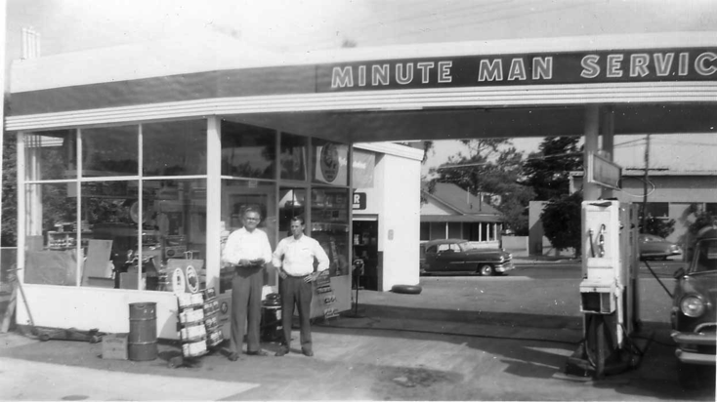
What is a Service
Allows resources to be easily provisioned on-demand
Typically middleware, frameworks, and other “components” necessary for applications
Can be a persistent, stateful layer

Slide 3

Two Types of Services
Managed - Fully integrated, with full lifecycle management
User-Provided – Created and managed external to the platform

Slide 4
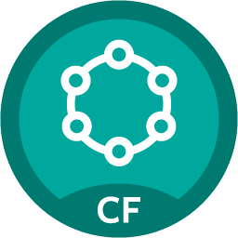
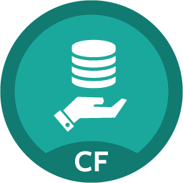

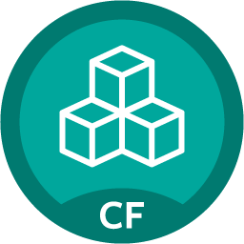



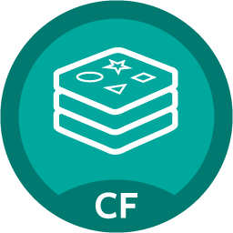

PCF – Functional Architecture
Single Platform and API for multiple Cloud Native workloads
API
Logs and Metrics
Routing
Buildpacks
PCF System Components
Common API
Partner
Services
Pivotal
Services
Garden Linux
Garden Windows
Notes:
After years of collaboration w/ MSFT and CF community
.NET apps are going to be first class citizens in Cloud Foundry
Same “cf push” experience with support for “day 2“ Operations – log aggregation, HA, scaling etc
Almost any .NET application will run as long as architectural principles of 12 factors/cloud native architecture are followed
Provides Windows containers with fast startup & high app density per host
Also Docker support is now beta with 1.6 (graduated from “experimental”)
Diego only supports secure registries bearing certificates signed by a common CA. Support for self-signed certs or custom-ca certs will be introduced in a subsequent release.
Day 2 Ops better w/ Enhanced Runtime – faster scaling, faster self healing, run highly elastic workloads at scale.
Security features
Operators can enforce secure traffic to the network edge of the platform in order to reduce the vulnerability of each application’s data in flight.
PCF Operators can enforce secure connections from their load balancers to the VMs on which the CF routers run, whereas before that termination happened at the load balancer. This improves the security of the traffic between applications and clients.
Ensures that a default CF installation doesn’t contain insecure or unsupported versions of application runtimes

Slide 5
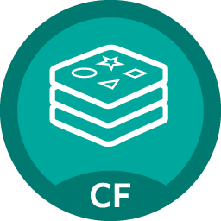
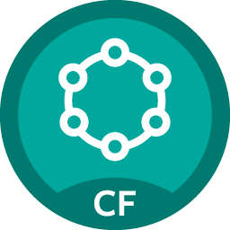


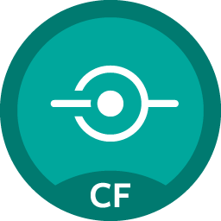






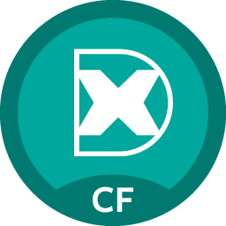



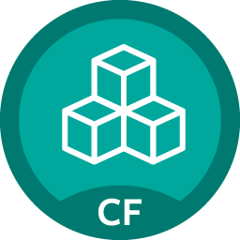

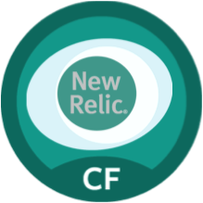

Pivotal Cloud Foundry Services
Mobile
Data
CI/CD
Cloud Native
DataStax Cassandra
Config Server
App
Distribution
Redis
Git Lab
Jenkins Enterprise
Service Directory
Push Notifications
MySQL
RabbitMQ
Monitoring
Circuit Breaker
Security
Data Flow
PivotalHD
App Dynamics
Single Sign-on
Session state caching
GemFire
Powered by
New Relic

Slide 6


D e m o
Notes:
Marketplace Walkthrough (if not done yet)
Network.pivotal.io walkthrough to show the services and how to download tiles as Operator

Slide 7
Data and Services – Pivotal Cloud Foundry and Big Data Suite
Provisioned Standalone
Provisioned and Managed by PCF
PivotalHD
Gemfire
MySQL
Cassandra
(DataStax)
Cloudbees
Jenkins
Concourse
Redis
MongoDB *
(10Gen)
Gitlab
Stayup.io
ELK
Greenplum
RabbitMQ
Kafka *
(Confluent)
JFrog
Artifactory
HAWQ
Spring XD
New Relic
Spring Cloud Services
Use Cases and Functionality
Big Data (SQL/ Analytics)
Transactional
OLTP
OLTP / Big Data (NoSQL)
App Dev
App Dev
Licensed and Support Provided By
Pivotal Big Data Suite (BDS)
PCF Services
Partner
Partner
Pivotal
* Not yet recommended for Production

Slide 8
TIBCO

Slide 9
Prior Art – Separate Infrastructure
Pivotal Cloud Foundry
Apps Manager
Cell
Cell
Cell
Cloud Native Application DevOps
Ops Manager
Cell
Cell
Cell
Consume APIs through user-provided services
BW Cluster
BW Studio (design time)
BW Engine
BW Engine
BW Engine
TIBCO DevOps
BW Admin (run time)
BW Engine
BW Engine
BW Engine

Slide 10
Current Art – Converged Infrastructure
Pivotal Cloud Foundry
Apps Manager
Cell
Cell
Cell
Cloud Native Application DevOps
Ops Manager
Cell
Cell
Cell
TIBCO Developers
BW Studio Container Edition
Cell
Cell
Cell

Slide 11
Recommended Application Structure
Front-End Applications
Presentation Logic
Use from anywhere
Business Services
Business Logic
Context-bounded, 12-factor, Cloud-Native services
Consumer Services
Consumer Services
Expose APIs with formats/protocols desired by consumers
Transform formats, sync/async
Enterprise Service Bus
Provider Services
Provider Services
Integrate with legacy IT systems, implement required workflow
Consume whatever protocol/format is exposed by legacy systems
Expose their features onto Enterprise Service Bus
IT Systems and Applications
Legacy Systems
Inconsistent, hard-to-consume APIs

Slide 12
Recommended Application Structure
Front-End Applications
Business Services
Focus Development Here
Move all business logic into context-bounded services
Third Platform
Modern Tools
Cloud Native
Supports Rapid, Continuous Development
The right place to use ESB software
Keep as thin and static as possible
Because it requires specialized knowledge and does not support rapid continuous development very well
Standardize consumer APIs (Restful/JSON)
Provider APIs are unchanging
RESTful APIs
Consumer Services
Enterprise Service Bus
Provider Services
IT Systems and Applications

Slide 13
Recommended Application Structure
Pivotal Cloud Foundry
Front-End Applications
Business Services
RESTful APIs
Run on the same platform
Common management, monitoring
Enables use of shared Infrastructure
Consumer Services
Enterprise Service Bus
Provider Services
IT Systems and Applications

Slide 14
Service Broker
Flexible, RESTful API
Allows Service Authors to provide self-provisioning Services to developers
Create
Cloud Controller
Service Broker
Service Nodes
Bind
Connect
Cell
Apps

Slide 15
Creating and Binding a Service
Service
credentials
DB
CLI
create service (HTTP)
Cloud Controller
create service (HTTP)
Service
Broker
reserve resources
Data
Service
Router
bind service (HTTP)
bind service (HTTP)
obtain connection data
Pivotal Cloud Foundry
Elastic Runtime
Notes:
An application runs in a CELL, which is a droplet execution agent. The Cloud Controller orchestrates the routing and lifecycle of all DEAs in the pool. Routers manage application traffic. Health Manager reports mismatched application states to the CC. A service gateway provides an interface for services (native or external). A messaging bus manages all system communication. Apps are accessed directly through the router while web and CLI clients (e.g., vmc, STS) access Cloud Controller via RESTful services.

Slide 16

Pivotal Cloud Foundry Services
Operated ‘as a Service’
Configured and integrated to enable push button deployment
Full lifecycle management - software updates and patching
Bind to apps through an easy-to-use interface
Common view into access control and audit trails across a breadth of services
EASY
Notes:
In many organizations, provisioning of data and messaging services for applications can take weeks, if not months because of the number of teams, administrators and exchange of credentials involved. We are striving to address this problem by providing a common model for services deployment via Pivotal Cloud Foundry that developers can easily find and their applications bind to – and scale those services as needed.
PCF Services allow administrators to provide pre-defined database and middleware services, and this gives developers the ability to rapidly deploy a software product from a menu of options without the typical slow and manual provisioning process. This is also done in a consistent and supportable way. PCF Services are managed and operated ‘as a Service,’ and this means they are automatically configured upon request. The provisioning process also incorporates full lifecycle management support, like software updates and patching.
This automation removes the overhead from developers, who are often saddled with service configuration responsibility. It makes administrators’ lives easier and addresses security risks by standardizing how services are configured and used.

Slide 17
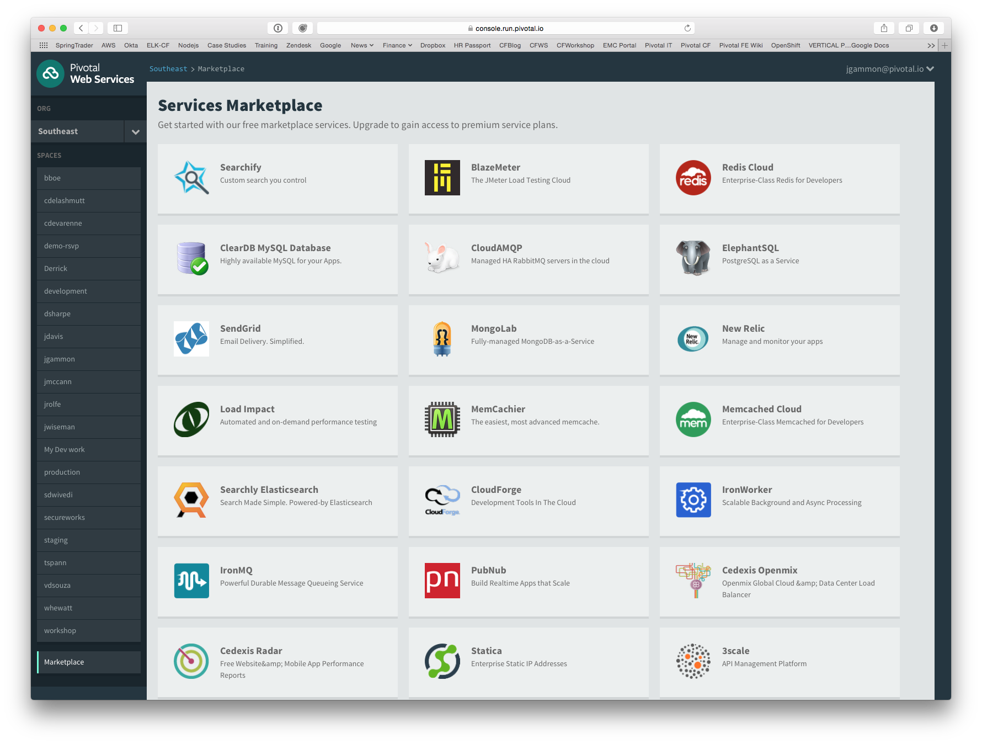
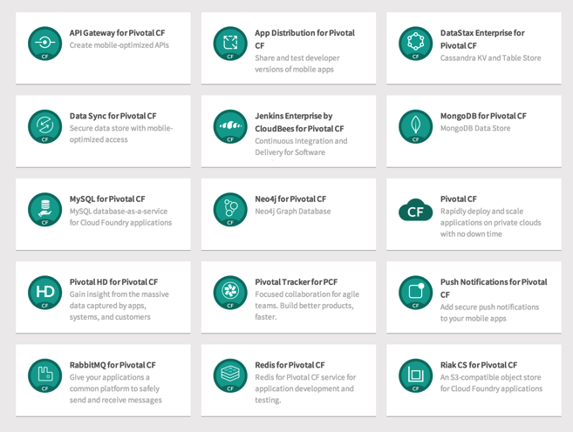
PCF Marketplace
Broad Services Ecosystem
Easy accessibility
Quick, self-provisioning

Slide 18
BDS Vision: Make all data products cloud-ready.
Open.
Agile.
Cloud-ready.
Pivotal BDS on PCF
Production: RabbitMQ, Redis, GemFire/Geode
Beta: PivotalHD (includes HAWQ), Data Flow

Slide 19
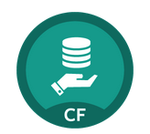
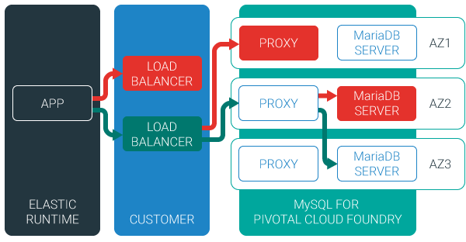
MySQL for Pivotal Cloud Foundry
Relational Database as a Service for Your Applications
Minimized effort to create, configure, and manage a MySQL cluster
Multi-node cluster
Data replication across nodes
Failover functionality ensures app traffic only routed to healthy nodes
Notes:
Deployed with a multi-node cluster; Balanced across Availability zones
Highly Available
Data replication
Failover functionality
Customizable plans
Secure - Different credentials to each application, operators can revoke access selectively!

Slide 20
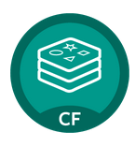
Redis for Pivotal Cloud Foundry
Advanced Key-Value Store and Cache as a Service
Pre-provision a pool of Redis VMs
Supports persistence to disk
Consolidated logging and monitoring
VM health monitoring, and recovery
User Application
Binding
Instance (Redis process)
VM
VM
VM
VM
Pre-provisioned VMs in the ‘pool’
Ready to be created as instances and bound with apps
Notes:
Developers can quickly develop features for their applications such as:
live, in-memory caching for very fast reads
real-time computation on data structures
ranked lists and leaderboards
publishing and subscribing
queuing

Slide 21
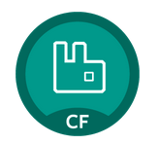
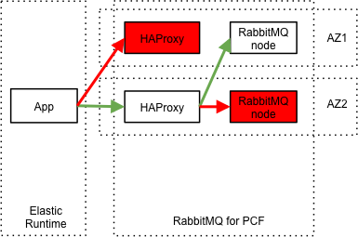
RabbitMQ for Pivotal Cloud Foundry
Apps safely send and receive messages at scale
Messaging broker for communication between servers, applications and devices
Highly available queues, flexible routing, support for multiple protocols and client libraries
Wide range of client libraries, in all languages
Push button deployment and upgrades of a RabbitMQ Cluster

Slide 22
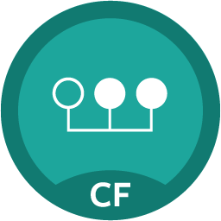
Session State Caching (SSC) by GemFire
Configure, manage, monitor, and consume GemFire in a client/server topology
A turn-key GemFire session replication cache service optimized for Java buildpack apps deployed in Tomcat
No need to modify your app
Tomcat from the java buildpack “knows” how to use the service
GemFire pre-configured for session replication
Session state management independent from app servers
App servers can come and go without affecting session lifetime
Not affected by load balancing

Slide 23




Diversity of clients, more load
In January 2014, mobile devices accounted for 55% of Internet usage in the United States. Apps made up 47% of Internet traffic and 8% of traffic came from mobile browsers.
http://money.cnn.com/2014/02/28/technology/mobile/mobile-apps-internet/
Notes:
When we established the predominant enterprise architecture paradigms, the vast majority of our clients were usually tethered to a desk with a workstation. Now that has flipped…

Slide 24
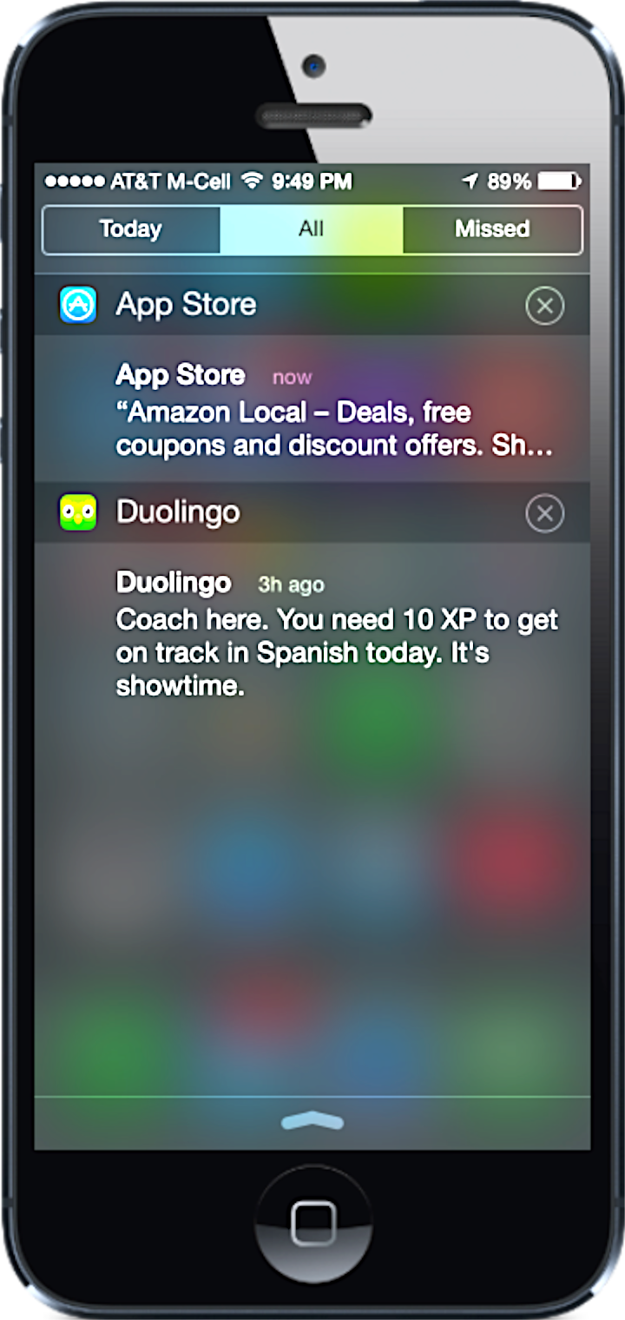
Push Notifications
Problem
Push is difficult to implement across platforms and at scale
Most existing push solutions are public / shared
Data owned by SaaS provider and cannot be fully leveraged by enterprise
Difficult to integrate SaaS push providers with services behind the firewall
Solution / Benefits
Dedicated, comprehensive solution built to scale
Full control of data and comprehensive logging / tracing
Direct integration with enterprise services

Slide 25
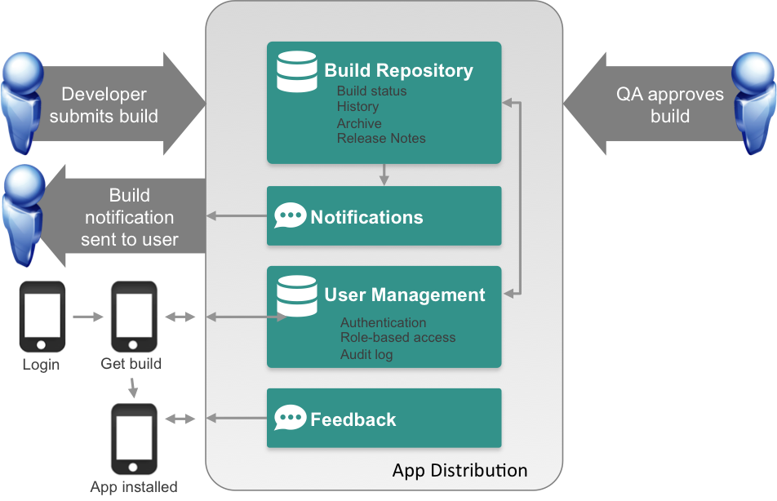
App Distribution
Problem
Extensive user testing of apps is critical to success
Difficult to distribute pre-release apps to test users
Existing solutions are public cloud
Solution / Benefits
Easy OTA app distribution
User / team management
Supports all major platforms
Private cloud for management

